Slide 1
Chapter 25
Halliday & Resnick’s
Fundamentals of Physics
Jearl Walker
Capacitance

Slide 2
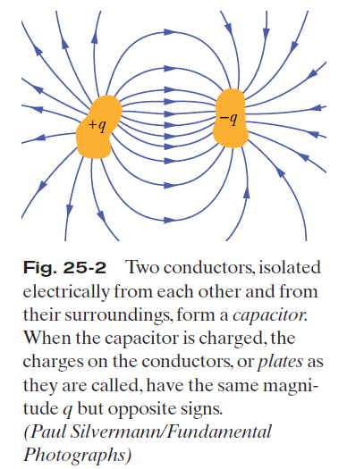
25.2: Capacitance:

Slide 3
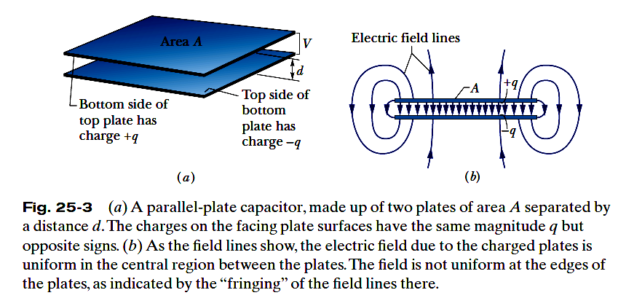

25.2: Capacitance:
When a capacitor is charged, its plates have charges of equal magnitudes but opposite signs: q+ and q-. However, we refer to the charge of a capacitor as being q, the absolute value of these charges on the plates.
The charge q and the potential difference V for a capacitor are proportional to each other:
The proportionality constant C is called the capacitance of the capacitor. Its value depends only on the geometry of the plates and not on their charge or potential difference.
The SI unit is called the farad (F): 1 farad (1 F)= 1 coulomb per volt =1 C/V.

Slide 4
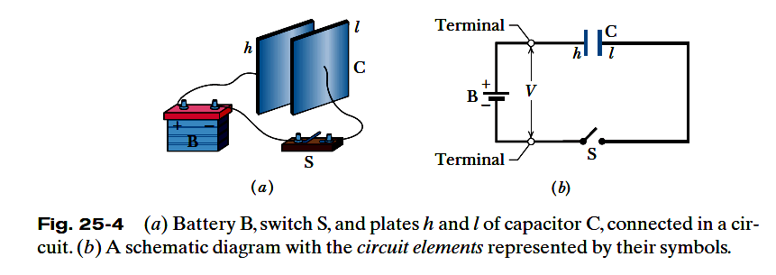
25.2: Charging a Capacitor:
The circuit shown is incomplete because switch S is open; that is, the switch does not electrically connect the wires attached to it. When the switch is closed, electrically connecting those wires, the
circuit is complete and charge can then flow through the switch and the wires.
As the plates become oppositely charged, that potential difference increases until it equals the potential difference V between the terminals of the battery. With the electric field zero, there is no further drive of electrons. The capacitor is then said to be fully charged, with a potential difference V and charge q.

Slide 5
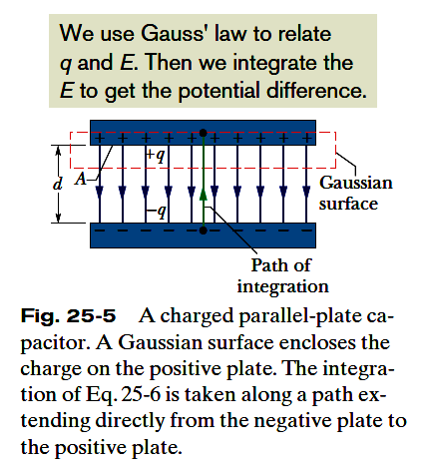








25.3: Calculating the Capacitance:
To relate the electric field E between the plates of a capacitor to the charge q on either plate, we use Gauss’ law:
Here q is the charge enclosed by a Gaussian surface and
is the net electric flux through that surface. In our special case in the figure,
in which A is the area of that part of the Gaussian surface through which there is a flux.
the potential difference between the plates of a capacitor is related to the field E by
If V is the difference V_{f} -V_{i} ,
Here,

Slide 6
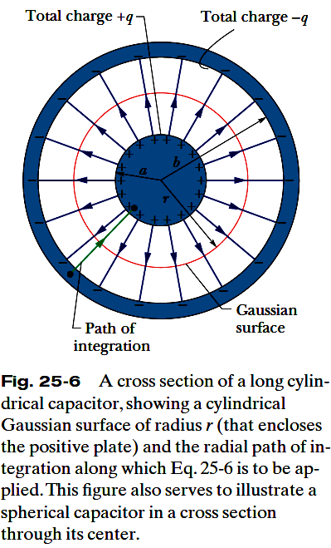




25.3: Calculating the Capacitance, A Cylindrical Capacitor :
As a Gaussian surface, we choose a cylinder of length L and radius r, closed by end caps and placed as is shown. It is coaxial with the cylinders and encloses the central cylinder and thus also the charge q on that cylinder.

Slide 7



25.3: Calculating the Capacitance, A Spherical Capacitor:

Slide 8
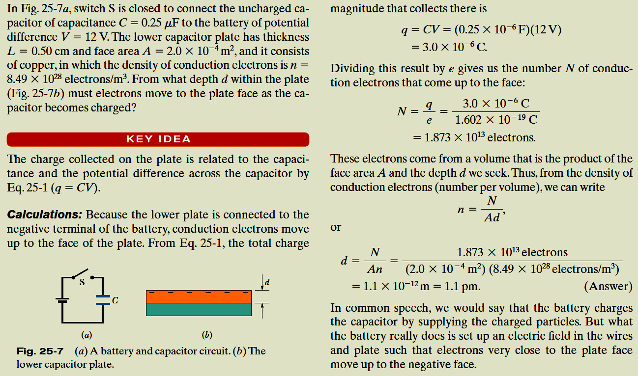
Example, Charging the Plates in a Parallel-Plate Capacitor:

Slide 9
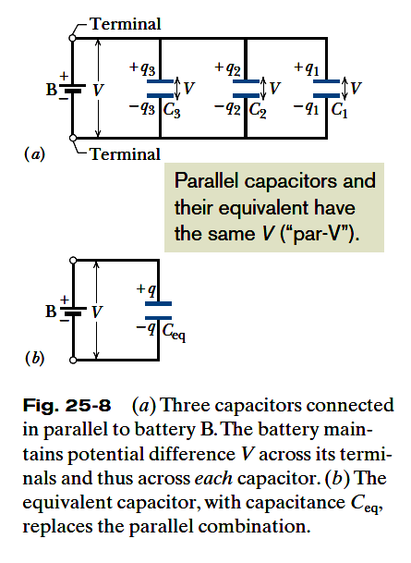


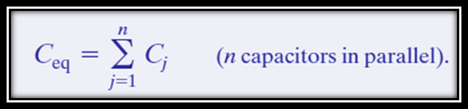
25.4: Capacitors in Parallel:
When a potential difference V is applied across several capacitors connected in parallel, that potential difference V is applied across each capacitor. The total charge q stored on the capacitors is the sum of the charges stored on all the capacitors.
Capacitors connected in parallel can be replaced with an equivalent capacitor that has the same total charge q and the same potential difference V as the actual
capacitors.

Slide 10
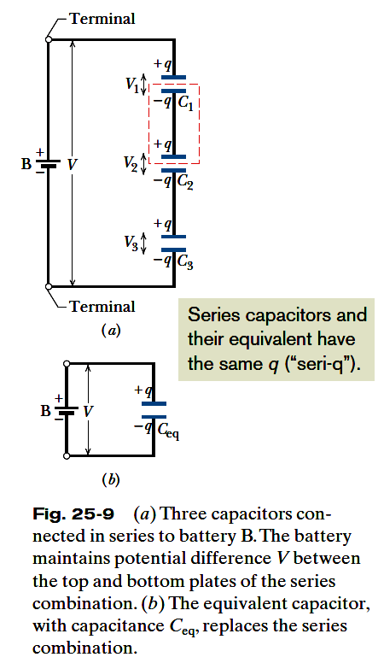




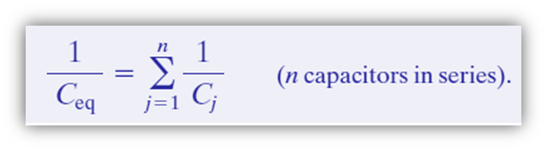
25.4: Capacitors in Series:
When a potential difference V is applied across several capacitors connected in series, the capacitors have identical charge q. The sum of the potential differences across all the capacitors is equal to the applied potential difference V.
Capacitors that are connected in series can be replaced with an equivalent capacitor that has the same charge q and the same total potential difference V as the actual series capacitors.

Slide 11
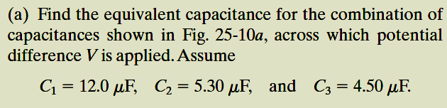
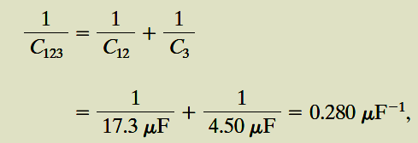

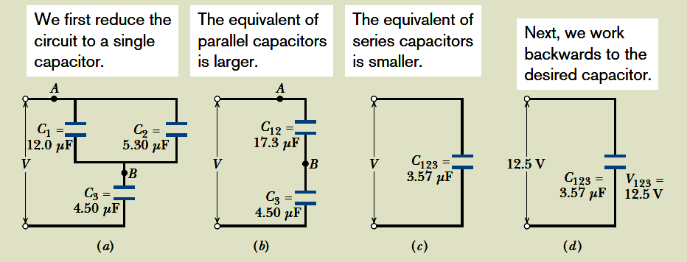

Example, Capacitors in Parallel and in Series:

Slide 12

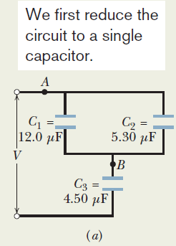
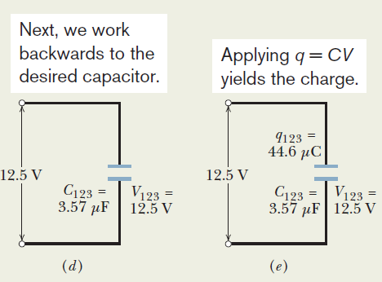


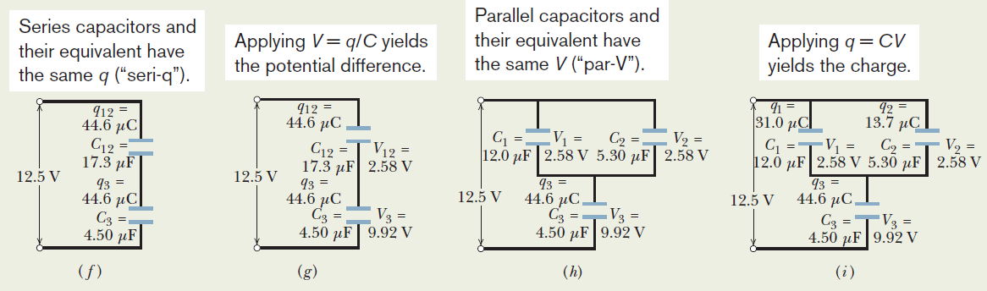
Example, Capacitors in Parallel and in Series:

Slide 13
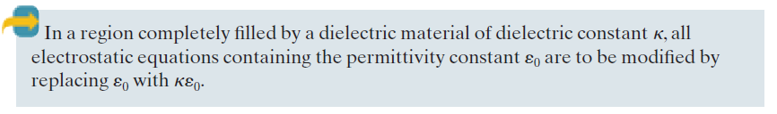
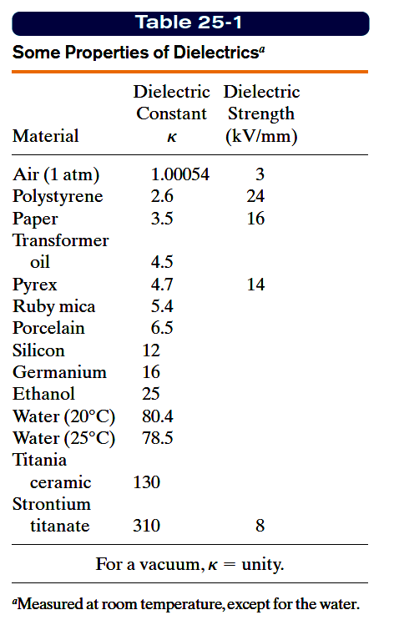
25.6: Capacitor with a Dielectric:
A dielectric, is an insulating material such as mineral oil or plastic, and is characterized by a numerical factor κ, called the dielectric constant of the material.
Some dielectrics, such as strontium titanate, can increase the capacitance by more than two orders of magnitude.
The introduction of a dielectric also limits the potential
difference that can be applied between the plates to a certain value Vmax, called the breakdown potential. Every dielectric material has a characteristic dielectric strength, which is the maximum value of the electric field that it can tolerate without breakdown.

Slide 14

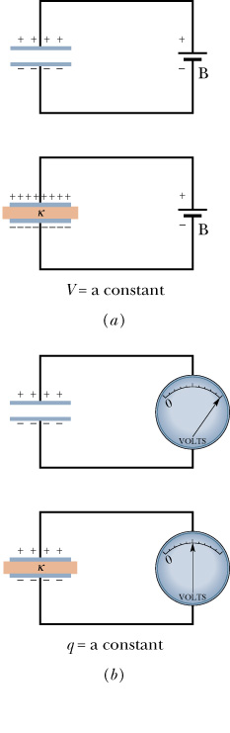
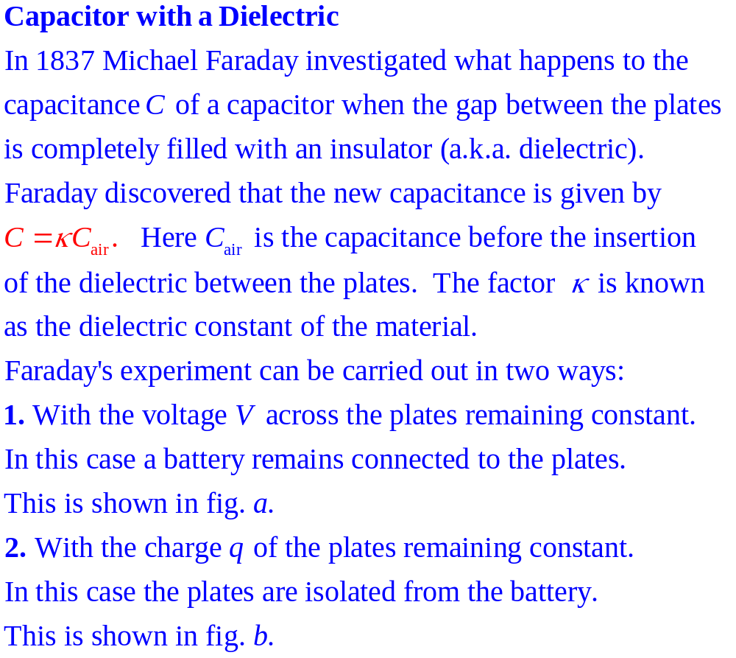
q
V
-q
q'
V
-q'
q
V
-q
V'
q
-q
(25-15)

Slide 15

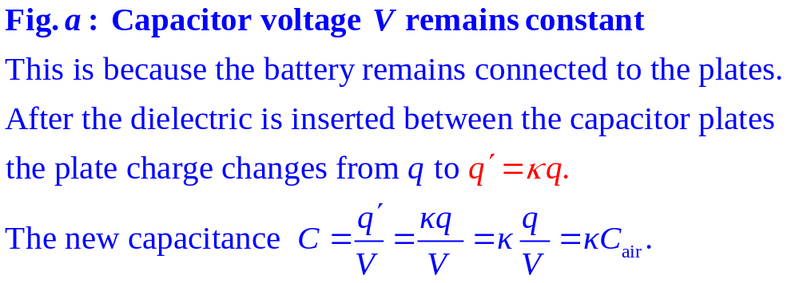
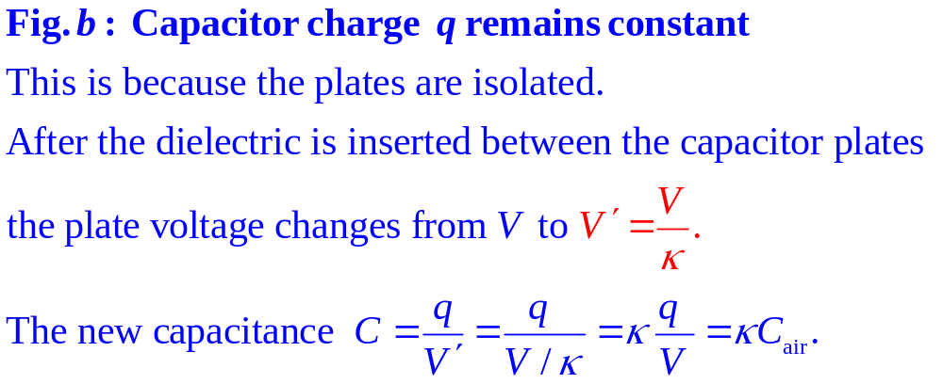
q
V
-q
q'
V
-q'
q
V
-q
q
V'
-q

Slide 16
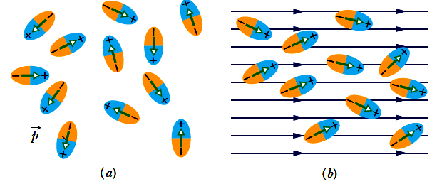
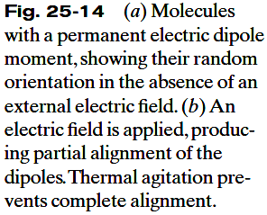
25.7: Dielectrics, an Atomic View:
Polar dielectrics. The molecules of some dielectrics, like water, have permanent electric dipole moments. In such materials (called polar dielectrics), the electric dipoles tend to line up with an external electric field as in Fig. 25-14. Since the molecules are continuously jostling each other as a result of their random thermal motion, this alignment is not complete, but it becomes more complete as the magnitude of the applied field is increased (or as the temperature, and thus the jostling, are decreased).The alignment of the electric dipoles produces an electric field that is directed opposite the applied field and is smaller in magnitude.
Nonpolar dielectrics. Regardless of whether they have permanent electric dipole moments, molecules acquire dipole moments by induction when placed in an external electric field. This occurs because the external field tends to “stretch” the molecules, slightly separating the centers of negative and positive charge.

Slide 17
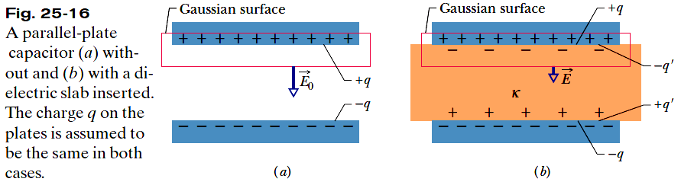
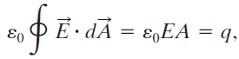




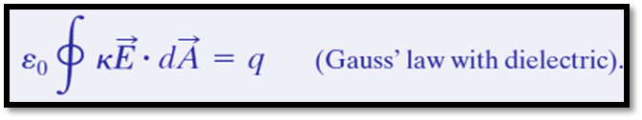

25.8: Dielectrics and Gauss’s Law:
For the situation of Fig. 25-16a, without a dielectric, the electric field between the plates can be found using Gauss’s Law. We enclose the charge q on the top plate with a Gaussian surface and then apply Gauss’ law. If E₀ represents the magnitude of the field, we have
In Fig. 25-16b, with the dielectric in place, we can find the electric field between the plates (and within the dielectric) by using the same Gaussian surface. Now the surface encloses two types of charge: It still encloses charge +q on the top plate, but it now also encloses the induced charge –q’ on the top face of the dielectric. The charge on the conducting plate is said to be free charge because it can move if we change the electric potential of the plate; the induced charge on the surface of the dielectric is not free charge because it cannot move from that surface.
The effect of the dielectric is to weaken the original field E₀ by a factor of κ:
Since

Slide 18
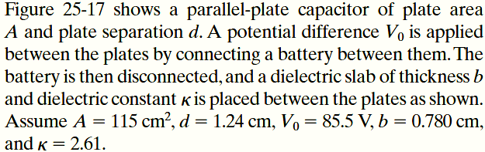

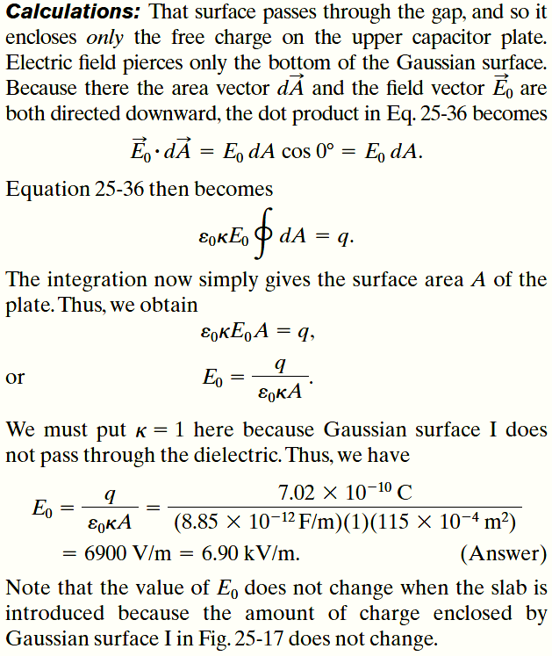
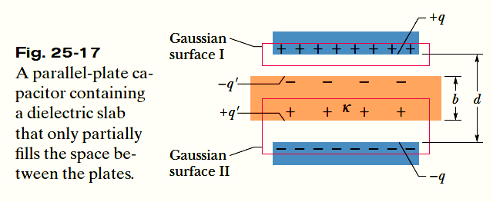
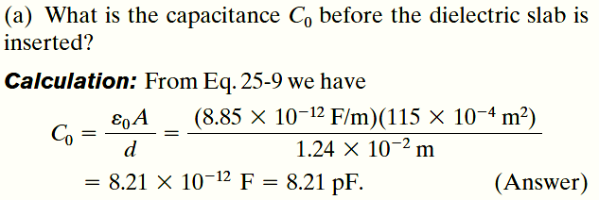
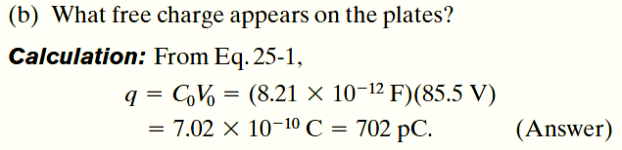
Example, Dielectric Partially Filling a Gap in a Capacitor:

Slide 19
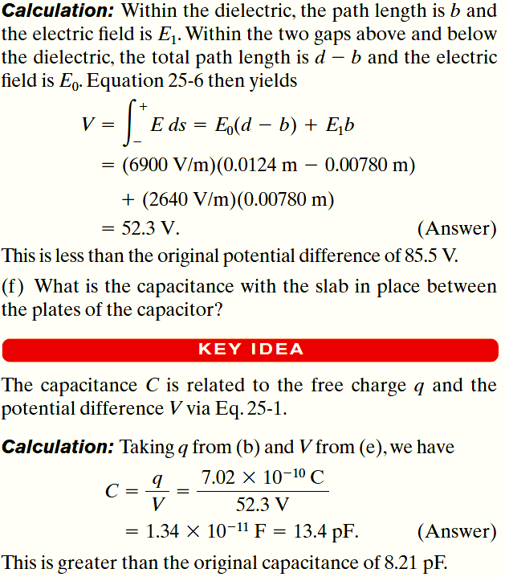
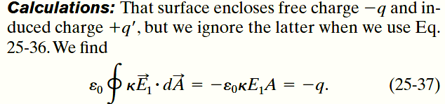
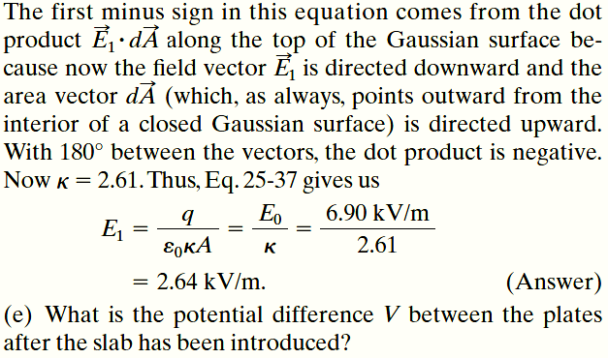
Example, Dielectric Partially Filling a Gap in a Capacitor, cont.:

